Slide 1
GA4 ANALYTICS
User Behavior
Analysis
Google Merch Shop · Jan 28 – Feb 24, 2026
49,943
6
28
17
Active Users
Exploration Types
Days Analyzed
Purchases

Slide 2
What's Inside
01
Free Form Exploration
04
Segment Overlap
Device & city breakdown — who visits and how
Audience intersection — paid vs mobile vs direct
02
Funnel Exploration
05
Cohort Analysis
Purchase journey — where users drop off
Retention — do users ever come back?
03
Path Exploration
06
User Lifetime
User journey mapping after landing
LTV by channel — which traffic is most valuable?

Slide 3
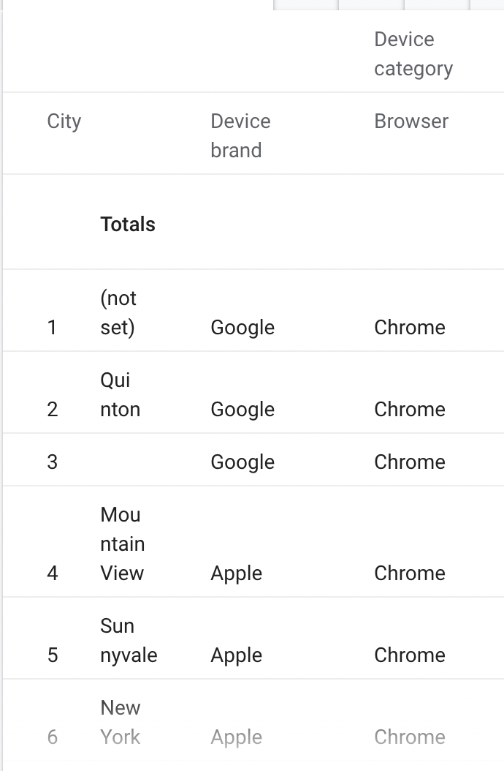
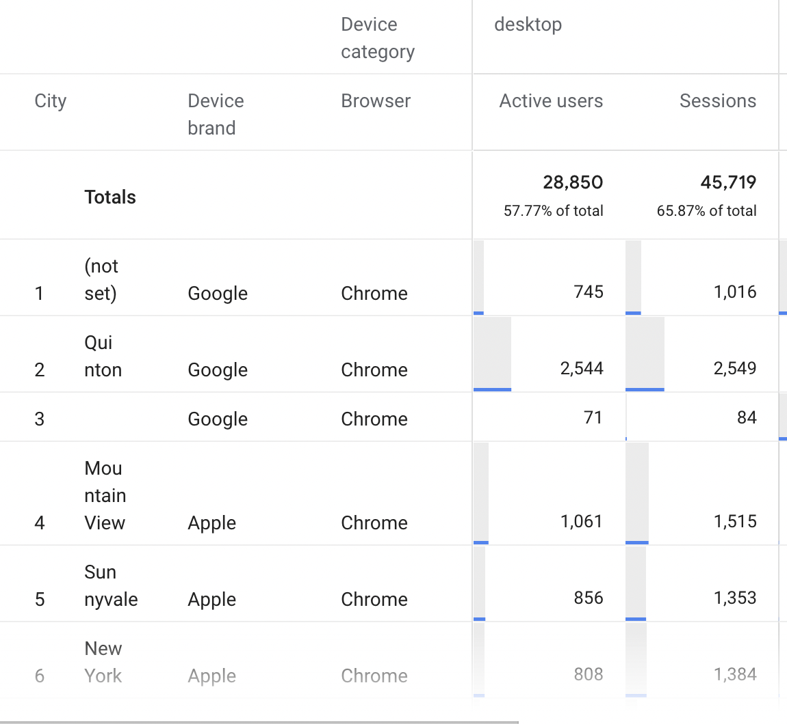
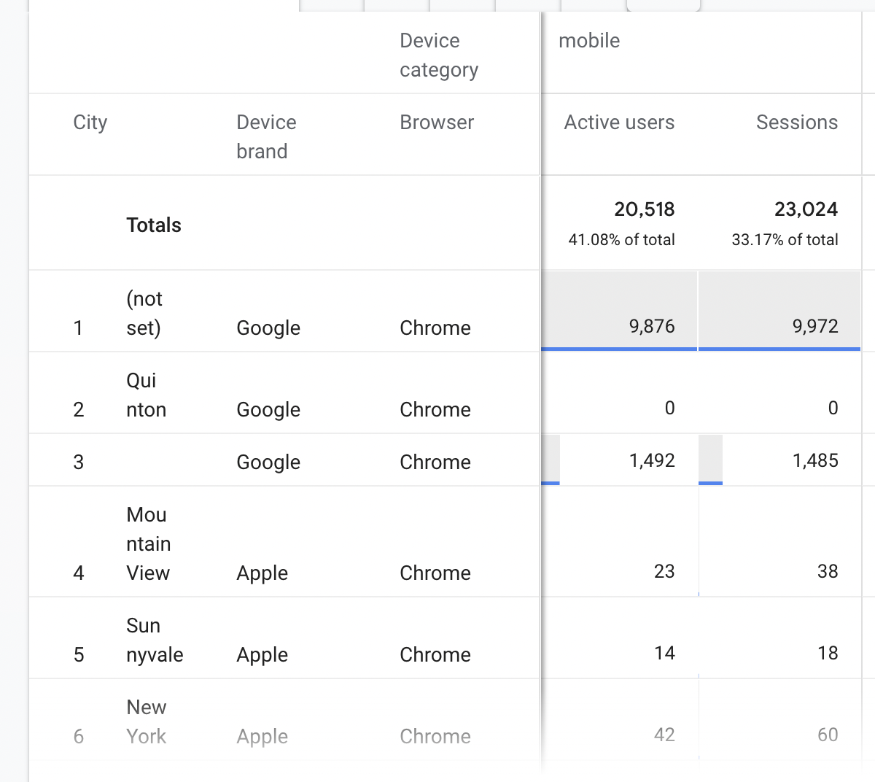
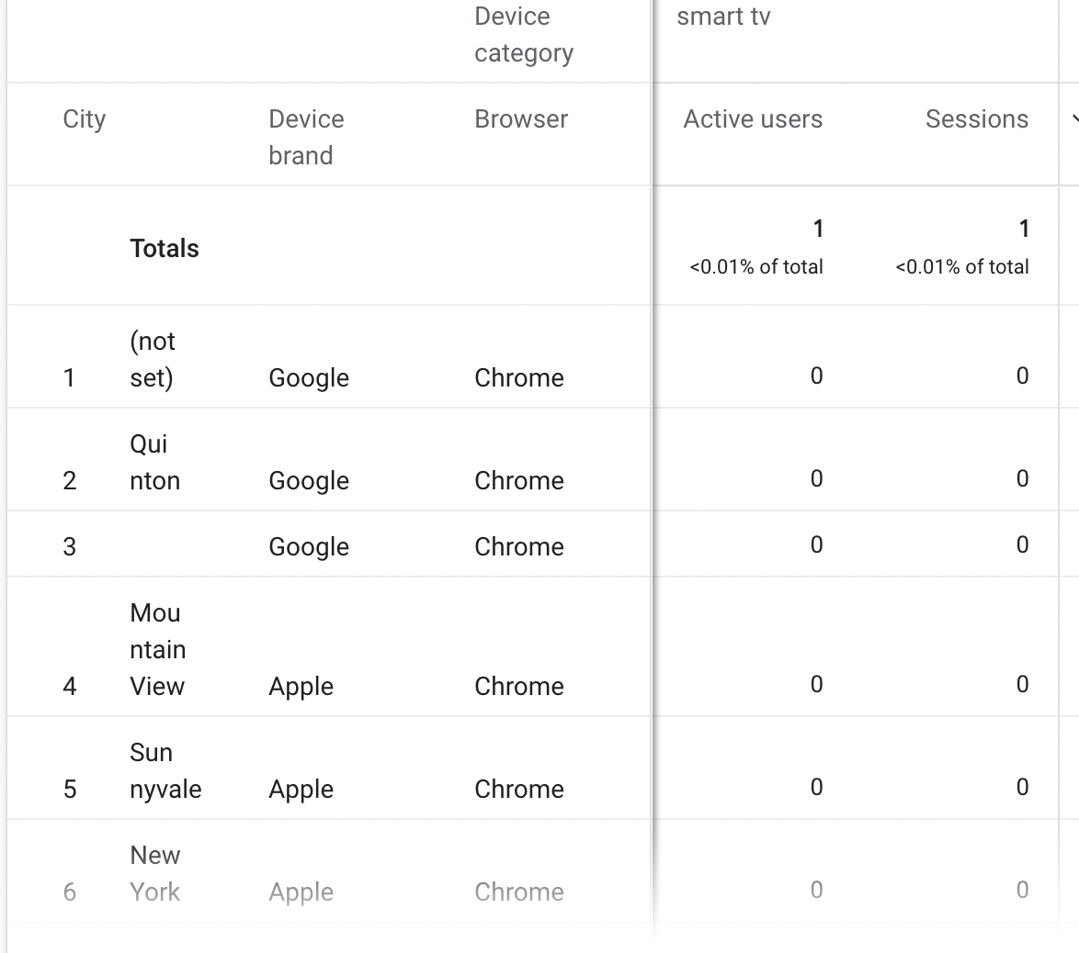
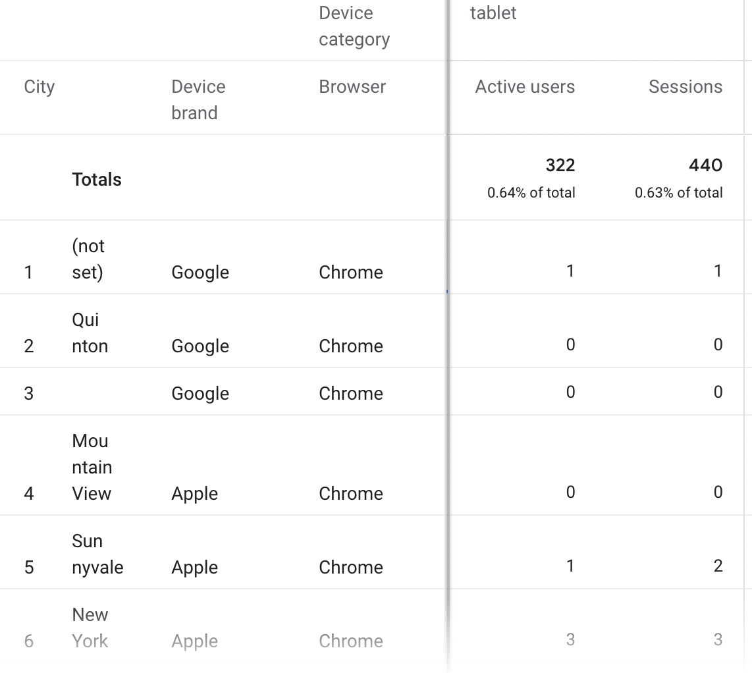
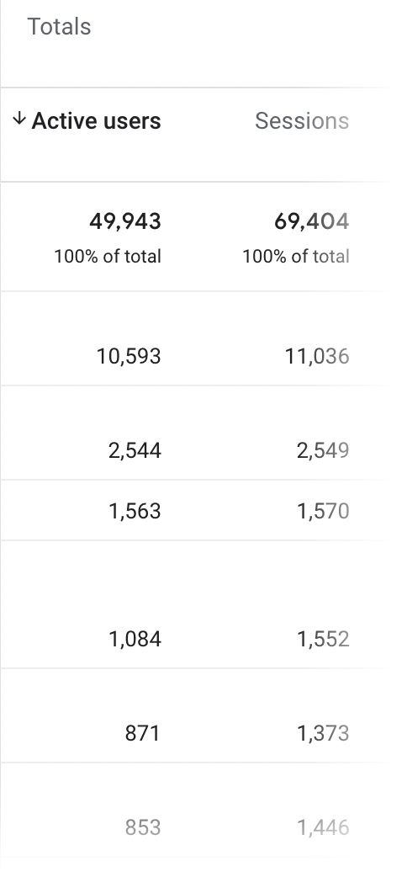
01
Free Form Exploration
How Are Users Visiting?

Slide 4
Free Form Exploration
Rows: City | Columns: Device Category | Values: Active Users + Sessions
DEVICE SPLIT
KEY FINDINGS
Desktop
57.8% (28,850)
Chrome = 100% of all browsers — zero optimization needed for other browsers
Mobile
41.1% (20,518)
9,876 mobile users have NO city data — major tracking gap
Tablet
0.64% (322)
Silicon Valley dominates — tech workers on Apple+Chrome
TOP CITIES BY DEVICE
City | Brand | Browser | Desktop | Mobile
(not set) | Google | Chrome | 745 | 9,876
Quinton | Google | Chrome | 2,544 | 0
Mountain View | Apple | Chrome | 1,061 | 23
Sunnyvale | Apple | Chrome | 856 | 14
New York | Apple | Chrome | 808 | 42
Quinton: 2,544 desktop, ZERO mobile — likely a corporate network

Slide 5
Free Form Report — Key Findings & Recommendations
Desktop is dominant at 57.8%: prioritize desktop experience first for any new features or redesigns.
Fix mobile tracking immediately: 9,876 mobile users have no location data, you are blind to nearly 10K users.
Chrome is 100% of all traffic: no need to test or optimize for Safari, Firefox or any other browser
Target Silicon Valley separately Mountain View, Sunnyvale and San Francisco are tech workers who behave differently from general audience
Ignore tablet completely: Only 322 users (0.64%) do not justify any dedicated optimization effort

Slide 6
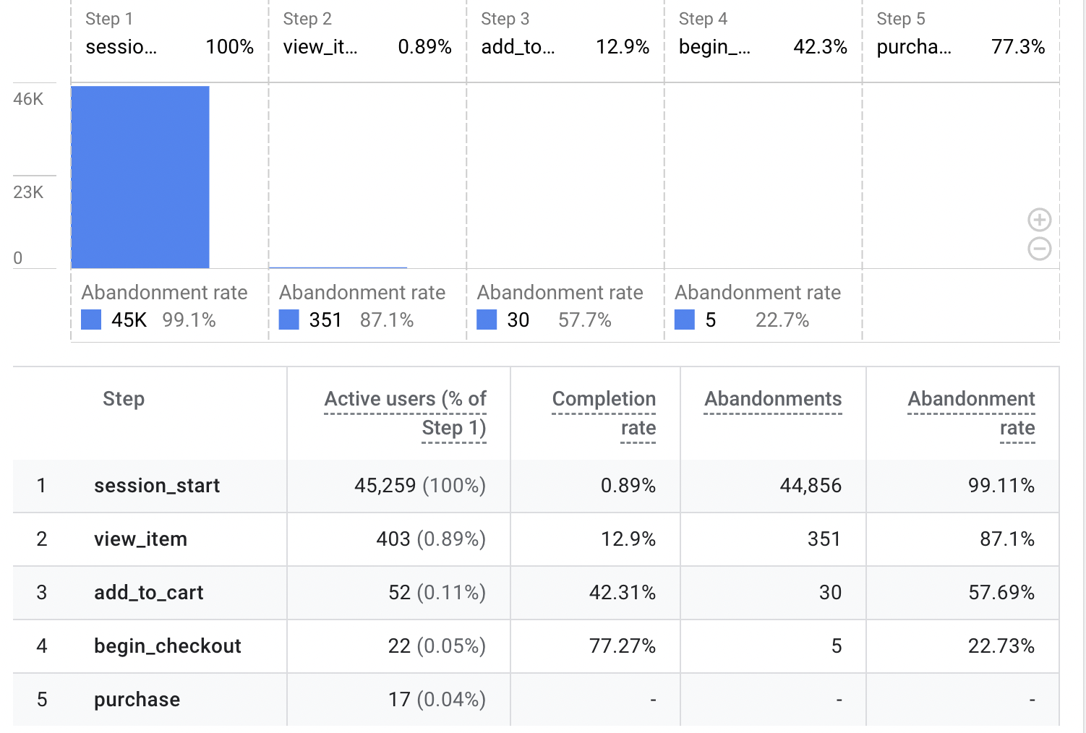
02
Funnel Exploration
Purchase Journey — Where Are Users Dropping Off?

Slide 7
Funnel Exploration
session_start → view_item → add_to_cart → begin_checkout → purchase
Session Start
45,259
View Item
403
-99.1%
Add to Cart
52
-87.1%
Begin Checkout
22
-57.7%
Purchase
17
-22.7%
CRITICAL: 99.1% of users abandon before viewing a single product — homepage navigation is the #1 priority fix

Slide 8
Funnel Analysis — Key Findings & Recommendations
99.1% of users never view a product on homepage fails to guide visitors to the catalog
87.1% who view a product don't add to cart , product pages need stronger CTAs and trust signals like reviews
57.7% abandon cart, retargeting emails and free shipping offers can recover these users
77.3% who start checkout complete it, payment experience is healthy, no changes needed
All optimization should focus on homepage product page , fixing this one step could multiply revenue without changing anything else

Slide 9
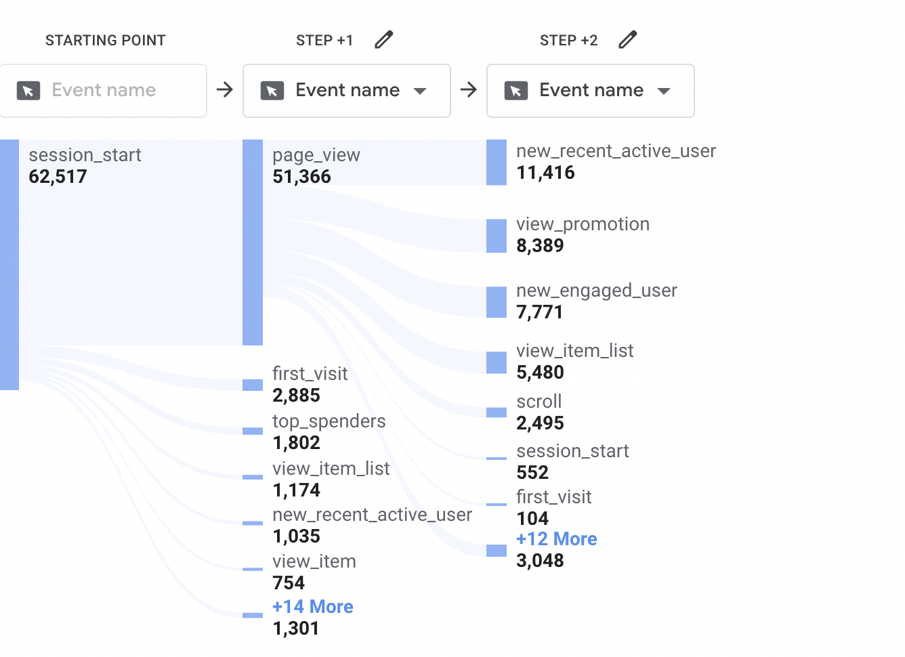
03
Path Exploration
User Journey Mapping — What Do Users Do After Landing?

Slide 10
Path Exploration
STEP +2
STEP +1
session_start
page_view
552
START
51,366
(82%)
session_start
first_visit
62,517
104
+19 Other
Events
+17 More
8,951
38,599
82% of sessions flow to a page_view — strong initial engagement
38,599 users take fragmented paths — highly scattered journeys after landing

Slide 11
Path Exploration— Key Findings & Recommendations
Target top_spenders (1,802) with personalized campaigns: They are your highest value audience.
Fix promotions: 8,389 users see them but aren't converting, promotion messaging needs to be stronger
Add product links inside item lists: users browse lists but aren't clicking into individual products

Slide 12
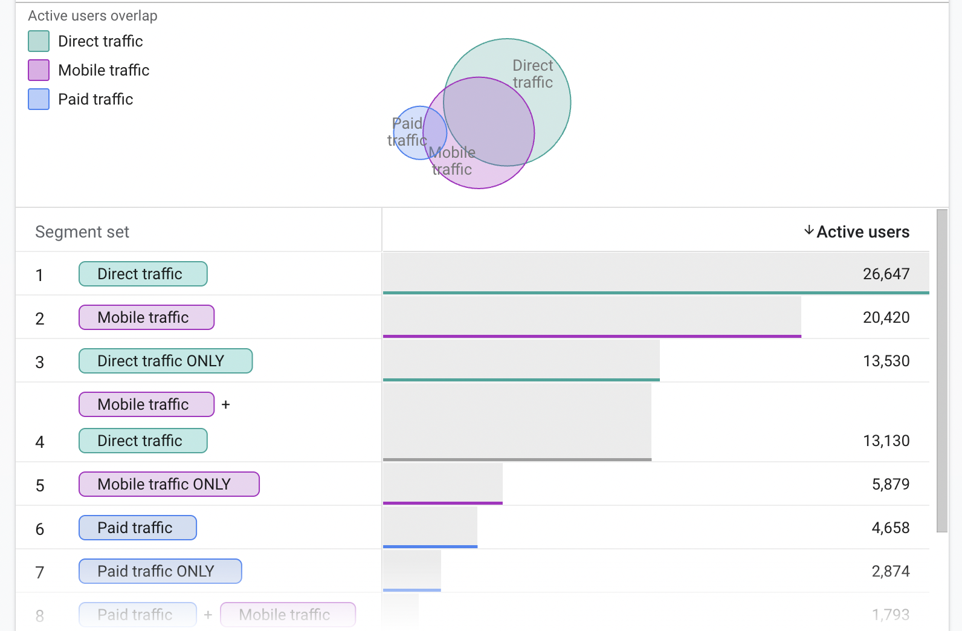
04
Segment Overlap
Audience Intersection — Paid vs Mobile vs Direct Traffic

Slide 13
Segment Overlap
Segment | Users
Direct Traffic (total) | 26,647
Mobile Traffic (total) | 20,420
Direct + Mobile overlap | 13,130
Mobile ONLY | 5,879
Paid Traffic (total) | 4,658
Paid + Mobile overlap | 1,793
Paid ONLY | 2,874
Direct
Traffic
Paid
4,658
26,647
13,130
overlap
20,420
Mobile
Traffic
64% of mobile users arrive directly — strong brand awareness on mobile
38% of paid traffic is mobile — paid landing pages must be mobile-optimized

Slide 14
Segment Overlap— Key Findings & Recommendations
Target top_spenders (1,802) with personalized campaigns: They are your highest value audience.
Fix promotions: 8,389 users see them but aren't converting, promotion messaging needs to be stronger
Add product links inside item lists: users browse lists but aren't clicking into individual products

Slide 15
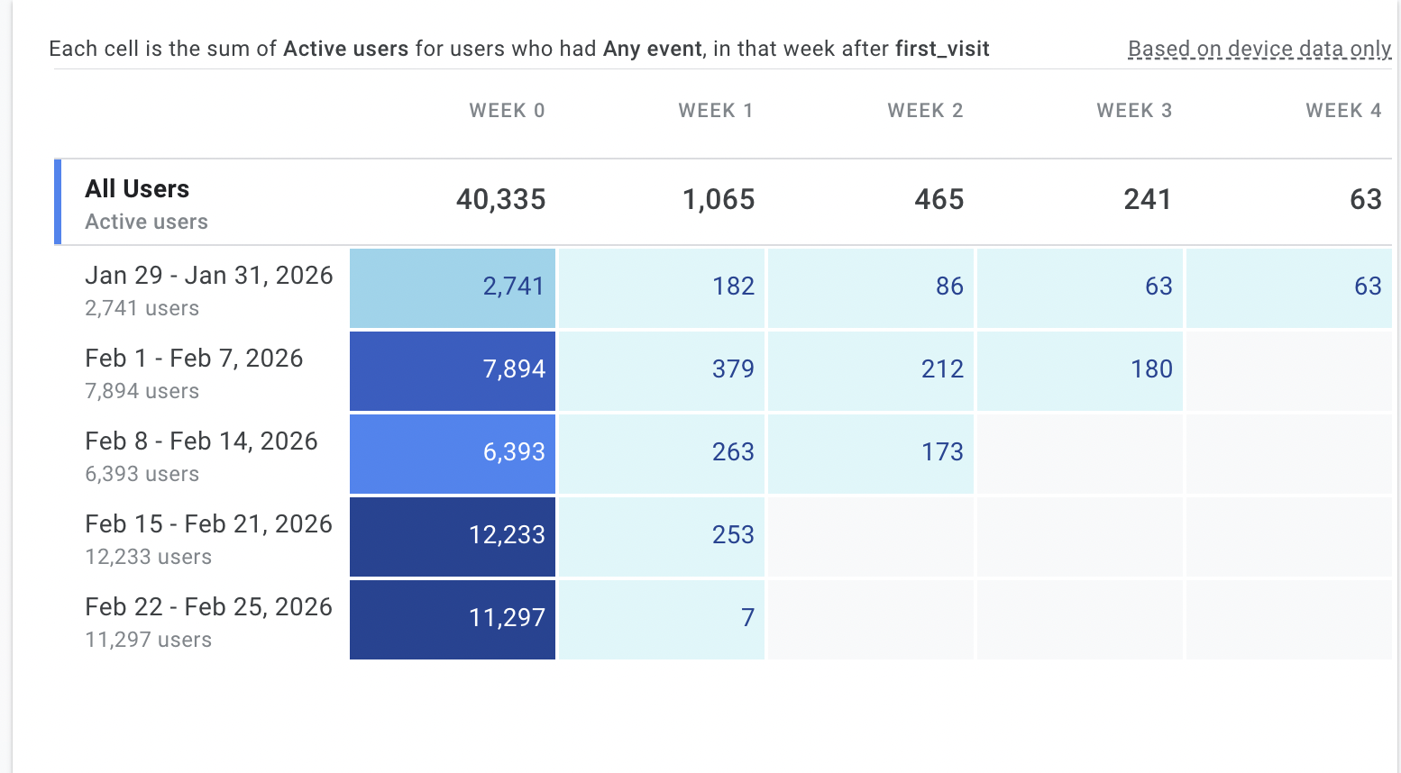
05
Cohort Analysis
User Retention — Do Users Come Back After Their First Visit?

Slide 16
Cohort Analysis
97.2%
1.8%
never return
after first visit
best cohort retention
(Jan 28–31 week)
Cohort | Week 0 | Week 1 | Week 2 | Week 3 | Week 4
All Users | 38,660 | 1,092 (2.8%) | 465 (1.2%) | 220 (0.6%) | 67 (0.2%)
Jan 28–31 ⭐ | 3,718 | 255 (6.9%) | 121 (3.3%) | 83 (2.2%) | 67 (1.8%)
Feb 1–7 | 7,894 | 379 (4.8%) | 212 (2.7%) | 140 (1.8%) | —
Feb 8–14 | 6,393 | 263 (4.1%) | 138 (2.2%) | — | —

Slide 17
Cohort Analysis— Key Findings & Recommendations
97.2% of users never return: Implement a Week 1 re-engagement email immediately.
January 28–31 had the best retention at 6.9%: Investigate what drove traffic that week and replicate it .
Capture emails on first visit: Gives a direct channel to bring users back through campaigns.
Add a loyalty incentive: offer a discount or free shipping on second purchase to encourage return visits.
Feb 15–21 retention dropped to 1.7%: investigate if a technical issue or poor campaign caused the decline.

Slide 18
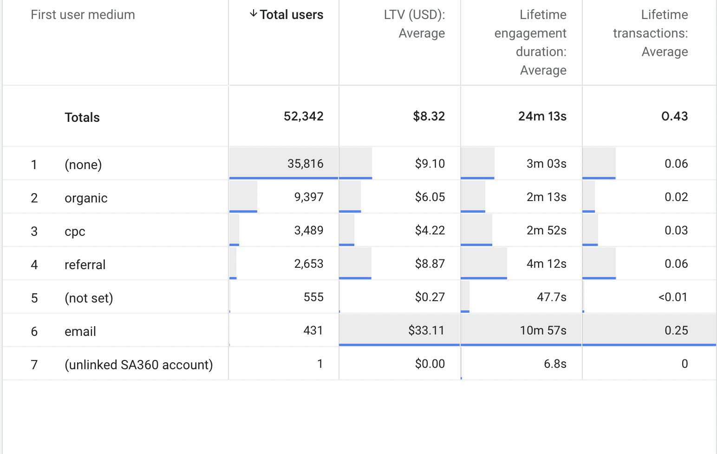
06
User Lifetime Analysis
LTV by Channel — Which Traffic Source Is Most Valuable?

Slide 19
User Lifetime Value by Channel
AVG LIFETIME VALUE (USD)
🏆 EMAIL USERS
Email 🏆
$44.22
Avg LTV
Direct
$8.99
$44.22
Engagement
Referral
$5.77
11m 21s
Transactions
Organic
$5.74
0.31 avg
Users
CPC/Paid
$5.35
243 only
(not set)
$0.29
Email = 0.5% of traffic but generates 5x higher LTV than any other channel — scale email marketing for maximum ROI

Slide 20
User Lifetime Analysis— Key Findings & Recommendations
Email has highest LTV at $33.11, 4x higher than any channel, prioritize growing email list
Paid ads lowest LTV at $4.22, least valuable users, review budget or improve targeting
Referral is underrated at $8.87 LTV, second best channel, find the source and invest more
Add email capture on every page, converting organic visitors to email subscribers is the biggest revenue opportunity

Slide 21
Strategic Recommendations
1. Fix Homepage Navigation
CRITICAL
5. Optimize Mobile for Paid
EFFICIENCY
99.1% abandon before viewing a product. Add product CTAs and improve homepage layout.
38% of paid traffic is mobile. Ensure paid landing pages are fully mobile-optimized.
2. Scale Email Marketing
HIGH ROI
4. Improve Week 1 Retention
GROWTH
Email users have 5x higher LTV ($44.22). Grow email list and automate re-engagement.
97% never return. Add a Week 1 email or push notification re-engagement sequence.
3. Fix Mobile Tracking
URGENT
24% of users (10K+) have no location data. Fix consent/GTM setup on mobile.

Slide 22
Skills Demonstrated
GA4 Explore
Funnel Analysis
Cohort Analysis
All 6 exploration types
Drop-off identification
Retention measurement
Segment Strategy
LTV Analysis
Data Storytelling
Audience overlap analysis
Channel value comparison
Insights and Recommendations

